Slide 1


Matrix Inverses and Solving Systems

Slide 2

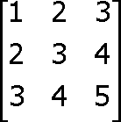

Warm Up
Multiple the matrices.
1.
Find the determinant.
2.
–1
3.
0

Slide 3
Objectives
Determine whether a matrix has an inverse.
Solve systems of equations using inverse matrices.

Slide 4
A matrix can have an inverse only if it is a square matrix. But not all square matrices have inverses. If the product of the square matrix A and the square matrix A^{–1} is the identity matrix I, then AA^{–1} = A^{–1} A = I, and A^{–1} is the multiplicative inverse matrix of
A, or just the inverse of A.

Slide 5
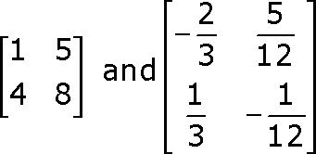
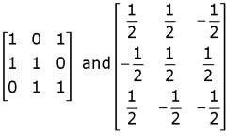
Example 1A: Determining Whether Two Matrices Are Inverses
Determine whether the two given matrices are inverses.
The product is the identity matrix I, so the matrices are inverses.
Example 1B: Determining Whether Two Matrices Are Inverses
Determine whether the two given matrices are inverses.
Neither product is I, so the matrices are not inverses.

Slide 6
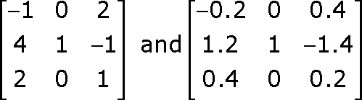
Example 1
Determine whether the given matrices are inverses.

Slide 7
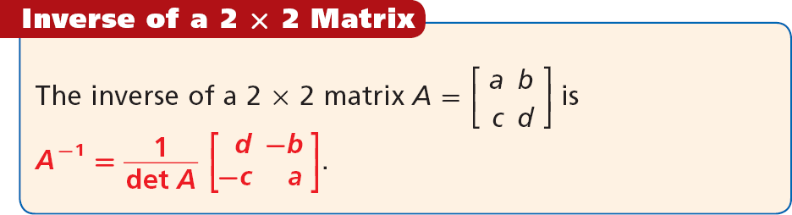



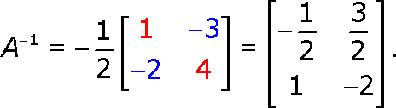
If the determinant is 0,
is undefined. So a matrix with a determinant of 0
has no inverse. It is called a singular matrix.
Example 2A: Finding the Inverse of a Matrix
Find the inverse of the matrix if it is defined.
First, check that the determinant is nonzero.
4(1) – 2(3) = 4 – 6 = –2. The determinant is –2, so the matrix has an
inverse.
The inverse of is

Slide 8
Example 2A: Finding the Inverse of a Matrix
Find the inverse of the matrix if it is defined.
First, check that the determinant is nonzero.
4(1) – 2(3) = 4 – 6 = –2. The determinant is –2, so the matrix has an
inverse.
The inverse of
is

Slide 9
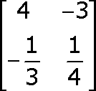

Example 2B: Finding the Inverse of a Matrix
Find the inverse of the matrix if it is defined.
The determinant is, no inverse.
, so B has

Slide 10
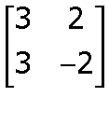
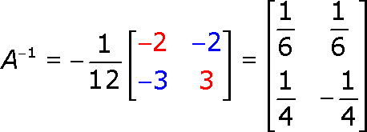
Example 2
Find the inverse of , if it is defined.
First, check that the determinant is nonzero. 3(–2) – 3(2) = –6 – 6 = –12
The determinant is –12, so the matrix has an inverse.

Slide 11
You can use the inverse of a matrix to solve a system of equations. This process is similar to solving an equation such as 5x = 20 by multiplying
each side by , the multiplicative inverse of 5.
To solve systems of equations with the inverse, you first write the matrix equation AX = B, where A is the coefficient matrix, X is the variable matrix, and B is the constant matrix.

Slide 12


is shown.
The matrix equation representing

Slide 13
To solve AX = B, multiply both sides by the inverse A⁻¹.
A⁻¹AX = A⁻¹B IX = A⁻¹B X = A⁻¹B
The product of A⁻¹ and A is I.

Slide 14
Caution!
Matrix multiplication is not commutative, so it is important to multiply by the inverse in the same order on both sides of the equation. A^{–1} comes first on each side.

Slide 15


Example 3: Solving Systems Using Inverse Matrices
Write the matrix equation for the system and solve.
Step 1 Set up the matrix equation.
A X = B
Write: coefficient matrix • variable matrix = constant matrix.
Step 2 Find the determinant.
The determinant of A is –6 – 25 = –31.

Slide 16
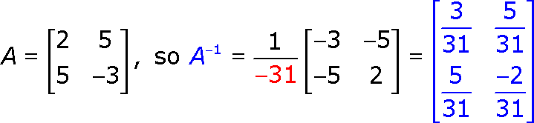
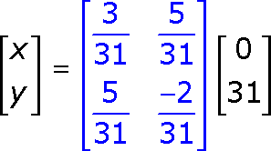

Example 3 Continued
Step 3 Find A^{–1}.
X =
_{A}-1
B
Multiply.
.
The solution is (5, –2).

Slide 17


Example 3
Write the matrix equation for
and solve.
Step 1 Set up the matrix equation.
A X = B
Step 2 Find the determinant.
The determinant of A is 3 – 2 = 1.

Slide 18



Example 3 Continued
Step 3 Find A⁻¹.
X =
_{A}-1
B
Multiply.
The solution is (3, 1).

Slide 19

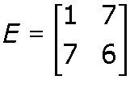
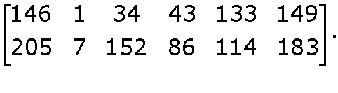
Example 4: Problem-Solving Application
Using the encoding matrix
,
decode the message

Slide 20



1
Understand the Problem
The answer will be the words of the message, uncoded.
List the important information:
The encoding matrix is E.
The encoder used M as the message matrix, with letters written as the integers 0 to 26, and then used EM to create the two-row code matrix C.

Slide 21


2
Make a Plan
Because EM = C, you can use M = E⁻¹C to decode the message into numbers and then convert the numbers to letters.
Multiply E⁻¹ by C to get M, the message written as numbers.
Use the letter equivalents for the numbers in order to write the message as words so that you can read it.

Slide 22


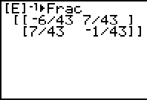

³ Solve
Use a calculator to find E⁻¹.
Multiply E⁻¹ by C. 13 = M, and so on
M
A T H _ I
S _ B E S T
The message in words is “Math is best.”

Slide 23


4 Look Back
You can verify by multiplying E by M to see that the decoding was correct. If the math had been done incorrectly, getting a different message that made sense would have been very unlikely.

Slide 24


Example 4
Use the encoding matrix to decode
this message
.

Slide 25
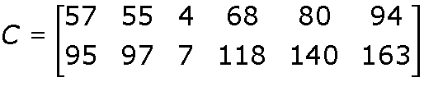
1
Understand the Problem
The answer will be the words of the message, uncoded.
List the important information:
The encoding matrix is E.
The encoder used M as the message
matrix, with letters written as the integers 0 to 26, and then used EM to create the two-row code matrix C.

Slide 26
2
Make a Plan
Because EM = C, you can use M = E⁻¹C to decode the message into numbers and then convert the numbers to letters.
Multiply E⁻¹ by C to get M, the message written as numbers.
Use the letter equivalents for the numbers in order to write the message as words so that you can read it.

Slide 27
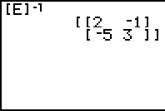

³ Solve
Use a calculator to find E⁻¹.
Multiply E⁻¹ by C.
18 = S, and so on
S
M A R T Y
_ P A N T S
The message in words is “smarty pants.”

Slide 28
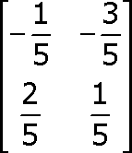


Lesson Quiz: Part I
1. Determine whether inverses.
and
are
2. Find the inverse of
, if it exists.

Slide 29


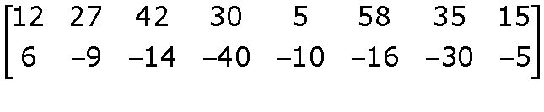
Lesson Quiz: Part II
Write the matrix equation and solve.
3.
4. Decode using
.

